Slide 1

Enhancing Sustainable Crop Protection through Machine Learning-Driven Integrated Strategies
TMP-2023-24-074

Slide 2

Team Members
Supervisor : Mr. Vishan Jayasinghearachchi
Co-Supervisor : Mr. Samadhi Rathnayake
Team Member Name | IT Number
Senanayake P.M. | IT20606756
Withanage P.W.E.L. | IT20600334
Wijesinha W.S.S | IT20641092
Anuththara R.M.C | IT20637064

Slide 3
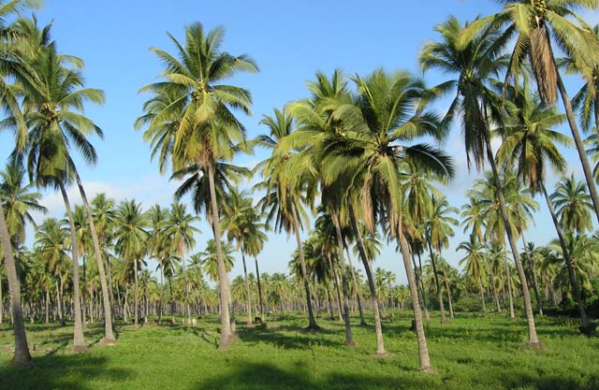
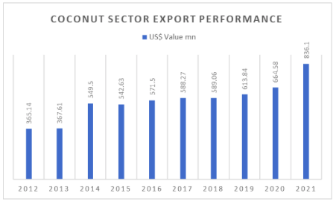
Introduction
Coconut Cultivation
One of the main cultivations in Sri Lanka

Slide 4
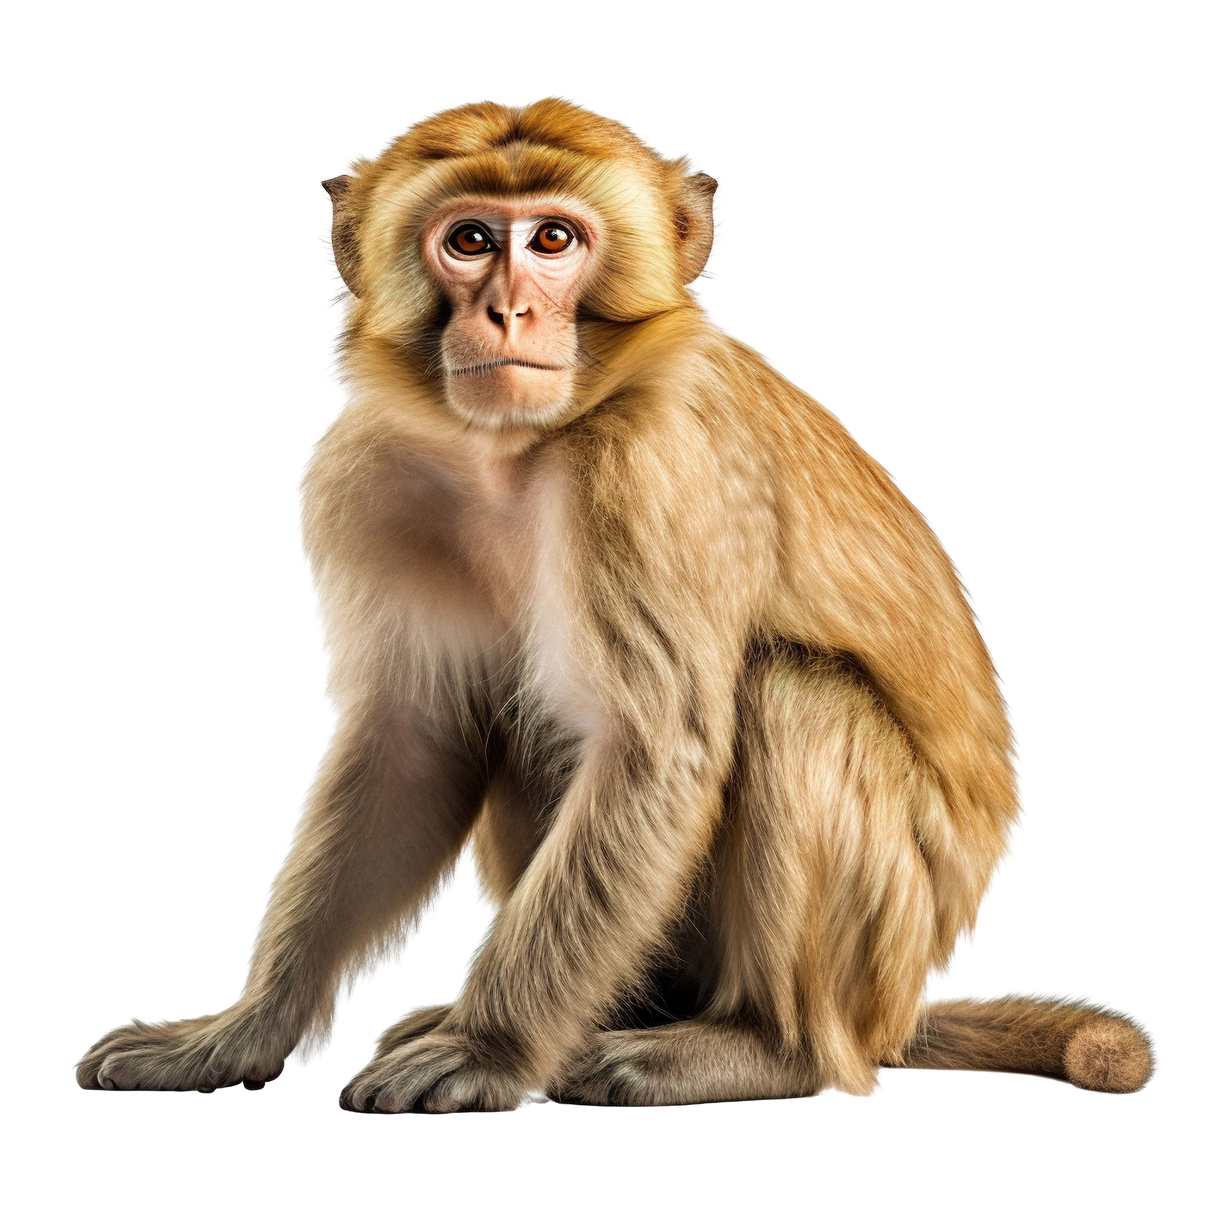
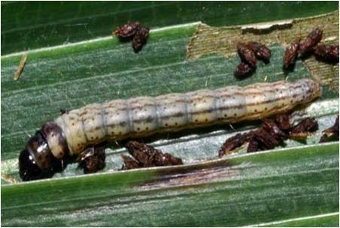
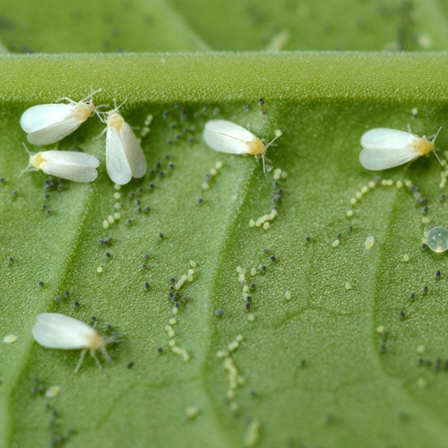
Introduction
Pest's Attacks in Coconut Cultivation
Macaque Monkey
Coconut Caterpillar
Coconut Whitefly
(Macaca)
(Opisona arenosella)
(Rialeurodes vaporariorum)

Slide 5
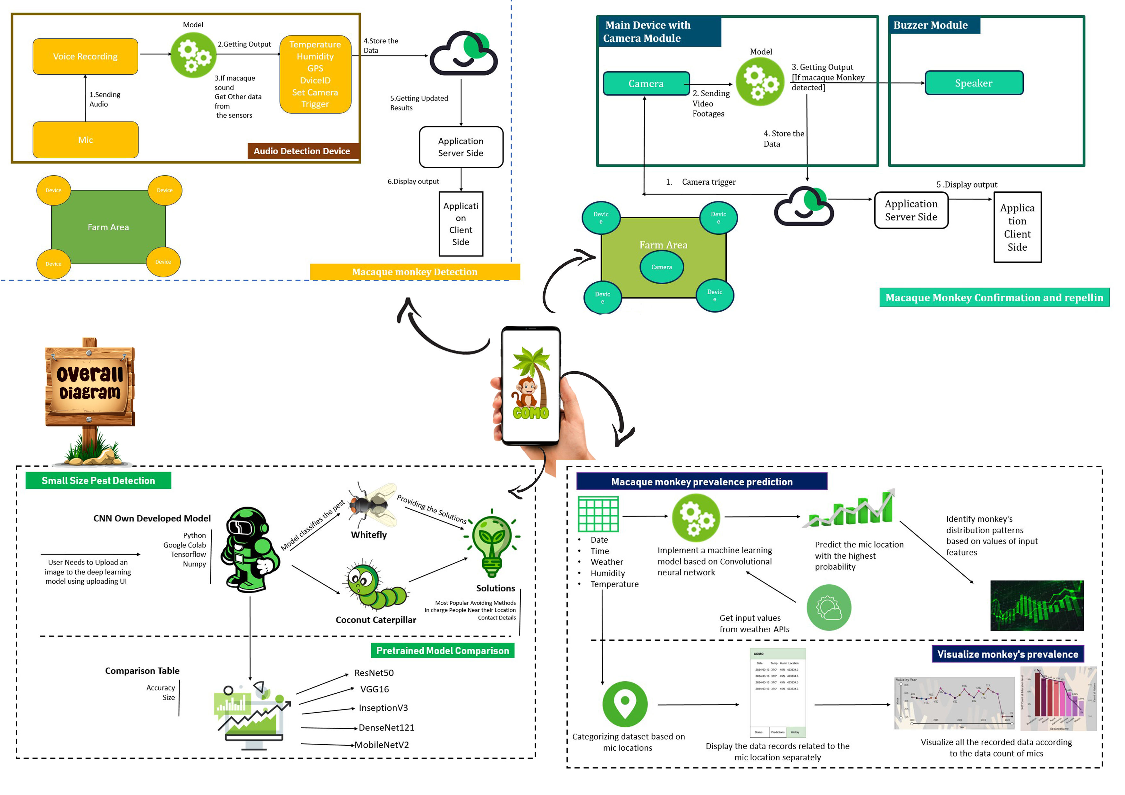
Overall Architecture

Slide 6
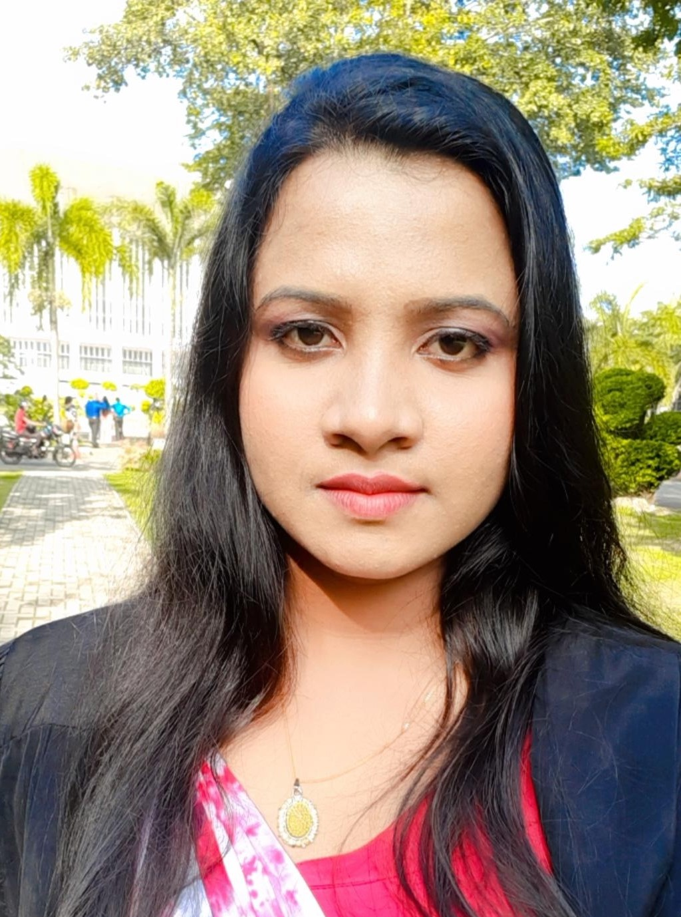
IT20641092 | Wijesinha W.S.S
Topic - Preliminary detection of presence of crop raiding macaque monkeys through audio analysis
Bachelor of Science (Hons) in Information Technology
Specializing in Software Engineering
IT20641092| Wijesinha W.S.S | TMP-2023-24-074

Slide 7
Introduction and Background
Macaque monkeys are huge problem in crop damage.
They can appear any time in the day.
How to detect the presence of macaque monkeys?
Smart solutions?
Identify the presence of macaque monkeys by their sound
real time monitoring by covering the farm area using mics
IT20641092| Wijesinha W.S.S | TMP-2023-24-074

Slide 8



Component Work Breakdown
Data Collection
Prediction Model Implementation
Audio Detection Device Making
Humidity and Temperature Sensor, GPS sensors integration to the device
Intergrated with Camera Device
Mobile UI to display detection history
IT20641092| Wijesinha W.S.S . | TMP-2023-24-074

Slide 9
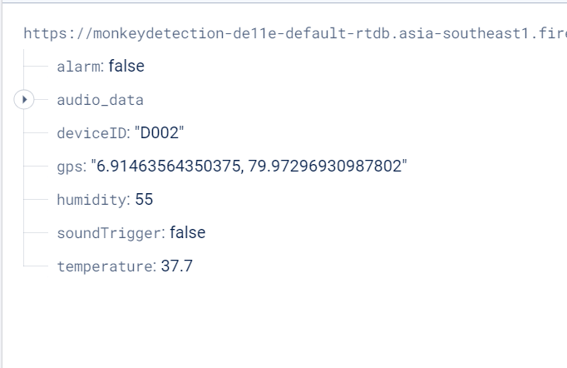
Component Methodology
Data Collection
Final Output to be store
M_1.wav
M_2.wav
M_3.wav
_
_
_
M_1035.wav
Ambient_1.wav
Ambient_2.wav
Ambient_3.wav
_
_
_
Ambient_1035.wav
IT20641092| Wijesinha W.S.S | TMP-2023-24-074

Slide 10



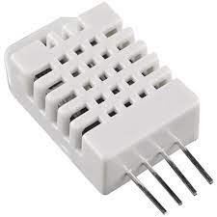
Tools and Software Used
Prediction Model Implementation
Classification Models with
RNN
Language - Python
Tools – Anaconda
Visual Studio code
Device Implementation
Raspberry Pi 3
Mic , GPS Sensor , DHD22
IT20641092| Wijesinha W.S.S | TMP-2023-24-074

Slide 11
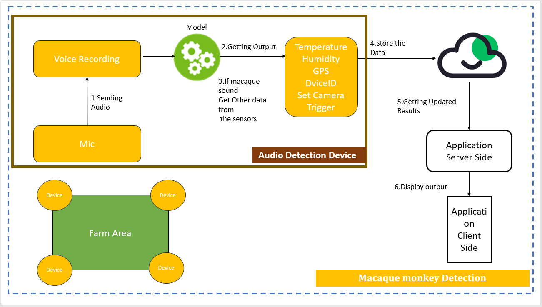
Architectural Diagram for Audio Detection Device

Slide 12
Hardware Implementation
Used mic device to getting the sound
Intergrated the mic with raspberry pi board
For getting Temperature, Humidity, GPS ; DHD22 and GPS sensor integrated with the raspberry board.
Used OLED display to display the device statues such as all the System online, Current sound level , Sound detected, Sound analysing, Monkey detected and other console lines
IT20641092| Wijesinha W.S.S | TMP-2023-24-074

Slide 13
Methodology
The device implemented to real time monitoring for 24 hours.
Get current sound level.
Initialized threshold limit and sounds which surpass that trigger the mic and get 4 seconds recording through audacity.
Analize the sound using model and get the predicted output.
If macaque sound using DHD22 get the temperature and humidity, Using gps sensor get the location of the device.
Update the data base with real time data
Set the sound trigger.
IT20641092| Wijesinha W.S.S | TMP-2023-24-074

Slide 14

IT20637064 | ANUTHTHARA R.M.C
Topic – Confirmation of macaque monkeys crop raiding and repelling macaque monkeys
Bachelor of Science (Hons) in Information Technology
Specializing in Software Engineering
IT20637064 | Anuththara R. M .C | TMP-2023-24-074

Slide 15

Introduction and Background
Method to confirm the presence of macaque monkeys
How do repel macaque monkeys
Alert the farmer about the presence of monkeys
IT20637064 | Anuththara R. M .C | TMP-2023-24-074

Slide 16
Component Work Breakdown
Data Collection
Prediction Model Implementation
Camera Module integration with Model
Alarm System integrate
Mobile Application UI design
Mobile Application Development
IT20637064 | Anuththara R. M .C | TMP-2023-24-074

Slide 17
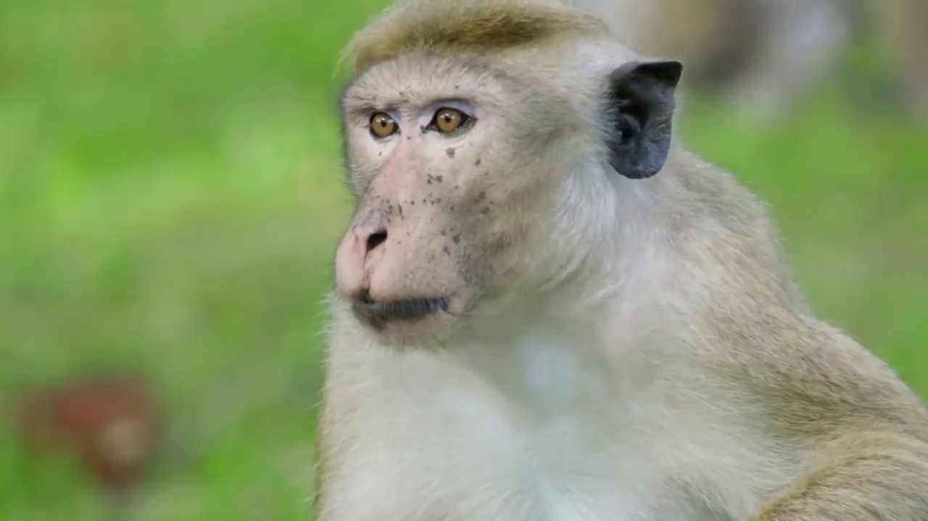
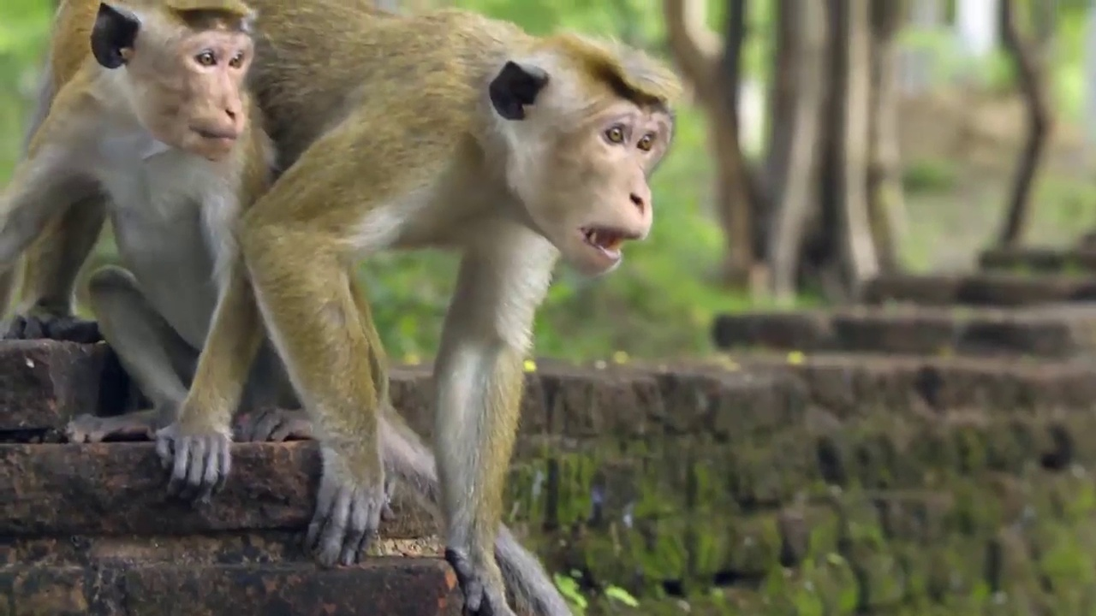
Component Methodology
Data Collection and Summarizing
National Zoological Gardens of Sri Lanka
IT20637064 | Anuththara R. M .C | TMP-2023-24-074

Slide 18

Tools and Software Used
Detection Model Implementation
Detection Models with YOLO
Language - Python
Tools – Anaconda
Visual Studio code
IT20637064 | Anuththara R. M .C | TMP-2023-24-074

Slide 19
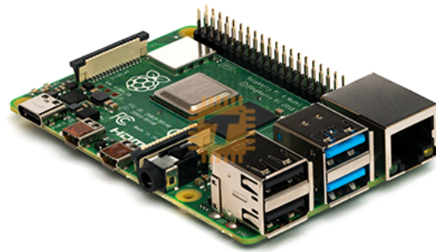
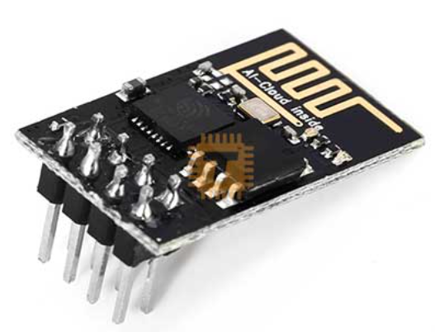
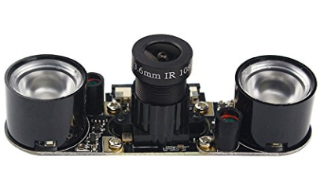
Tools and Software Used
Device Implementation
Raspberry Pi 4
Camera module
Buzzer Module
IT20637064 | Anuththara R. M .C | TMP-2023-24-074

Slide 20


Main Device with Camera Module
Buzzer Module
Model
3. Getting Output
[If macaque Monkey detected]
Camera
Speaker
2. Sending
Video Footages
4. Store the Data
Camera trigger
5 .Display output
Application
Server Side
Application Client Side
Device
Device
Farm Area
Camera
Device
Device
Macaque Monkey Confirmation and repellin

Slide 21

Hardware Implementation
Used camera module to get the footage
Intergrated the camera with raspberry pi board
Intergrated the Buzzer module
Used OLED display to display the device statues such as all the System online, Sound detected, Monkey detected and other console lines
IT20641092| Wijesinha W.S.S | TMP-2023-24-074

Slide 22

Methodology
The device implemented to real-time object detection
system continues to monitor the area
Analize the video footages using model and get the predicted output.
Upon detection of macaque monkeys buzzer is triggered to emit a sound alert
Update the data base with real time data
IT20641092| Wijesinha W.S.S | TMP-2023-24-074

Slide 23
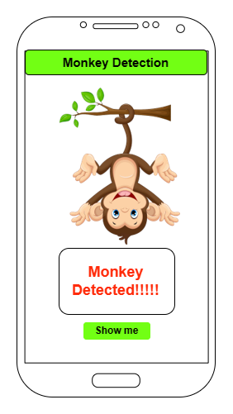



Component Methodology
Mobile Application Design

Slide 24
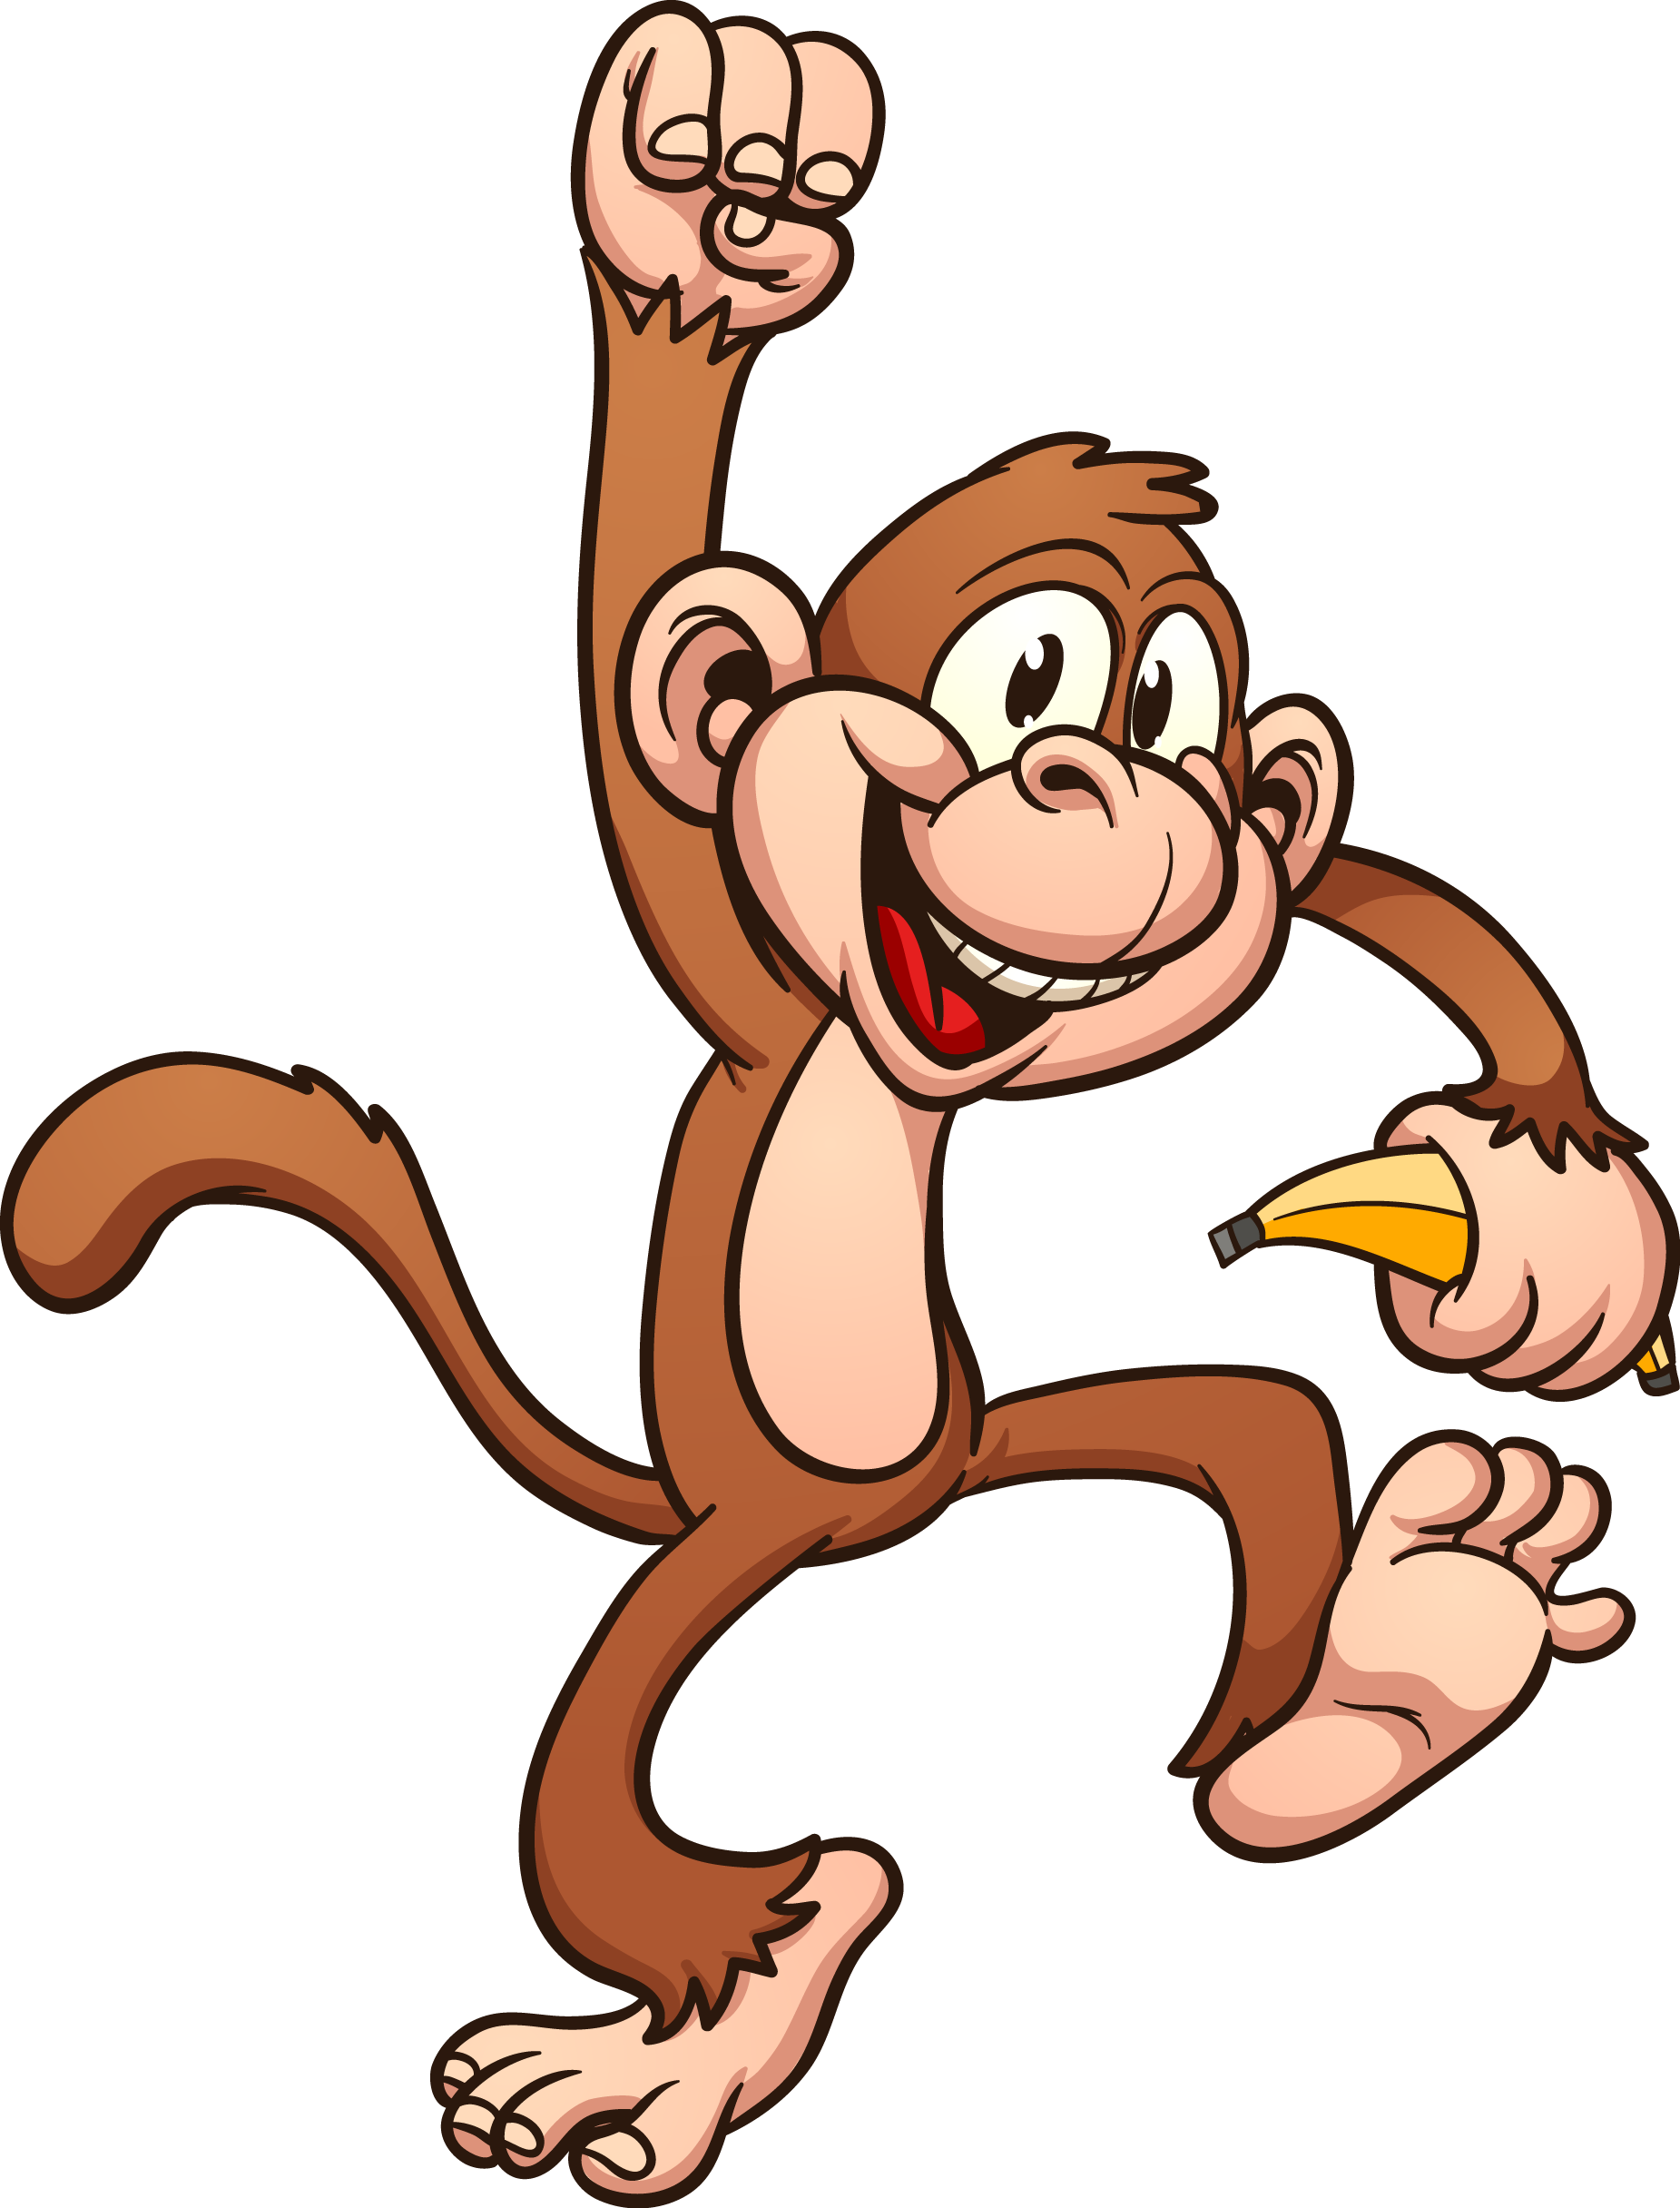
Component Methodology
Challengers Faced
Limited Hardware Resources
Performance Optimization
Acquiring Annotated Training Data
Solutions .....
Dockerizing the object detection model introduced
automated data augmentation techniques were applied

Slide 25

IT20606756 | Senanayake p.m.
Topic - Analyzing data to elaborate on macaque monkey prevalence and behavior patterns
Bachelor of Science (Hons) in Information Technology
Specializing in Data Science
IT20606756 | Senanayake P.M. | TMP-2023-24-074

Slide 26

Introduction and Background
When will Monkeys come?
Which will be the direction?
What will happen in the future?
IT20606756 | Senanayake P.M. | TMP-2023-24-074

Slide 27

Introduction and Background
Outcomes would be .....
Predict the future risk to the farmer by analyzing macaque monkey's presence and behavior patterns.
Demonstration of monkey distribution and behavior through data visualization.
IT20606756 | Senanayake P.M. | TMP-2023-24-074

Slide 28
Component Work Breakdown
Data Collection and Summarizing
Prediction Model Implementation
Retrieve Model Input Values From Weather API
Mobile Application Design
Mobile Application Development
Monkey's Visitation Patterns Visualization
Real World Testing
IT20606756 | Senanayake P.M. | TMP-2023-24-074

Slide 29
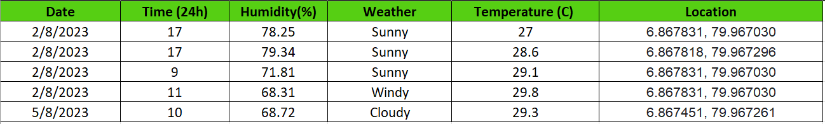
Component Methodology
Coordinates | Mic Station
6.867831, 79.967030 | MIC 01
6.867818, 79.967296 | MIC 02
6.867818, 79.967501 | MIC 03
6.867690, 79.967585 | MIC 04
6.867536, 79.967425 | MIC 05
6.867451, 79.967261 | MIC 06
6.867603, 79.967033 | MIC 07
Data Collection and Summarizing
Field Location
Data Count - 900 records
IT20606756 | Senanayake P.M. | TMP-2023-24-074

Slide 30

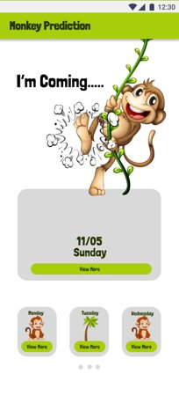
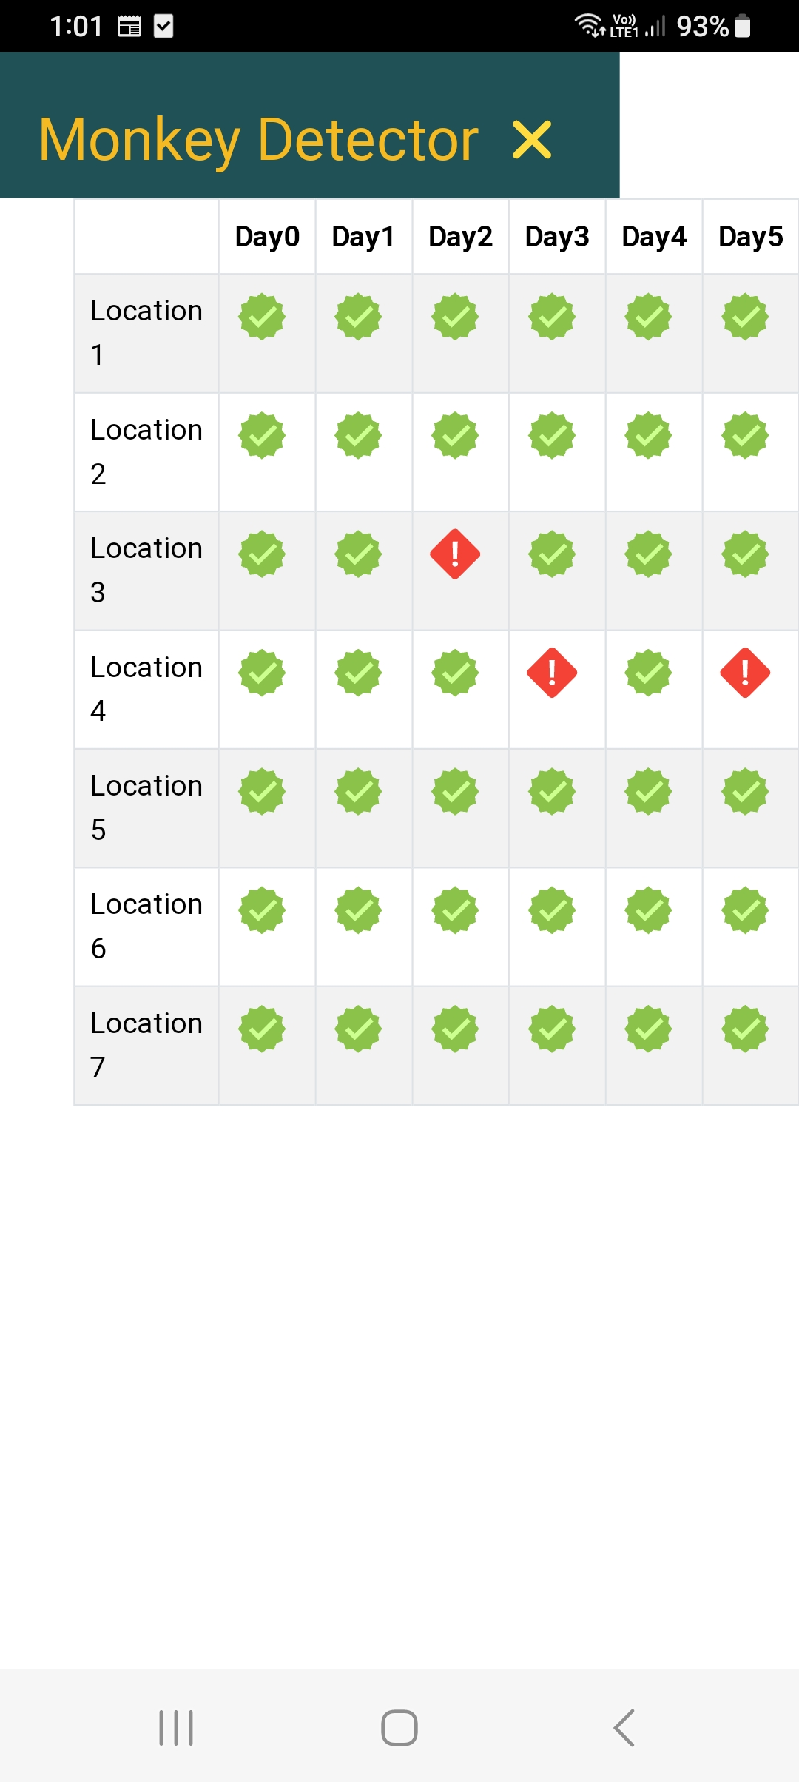
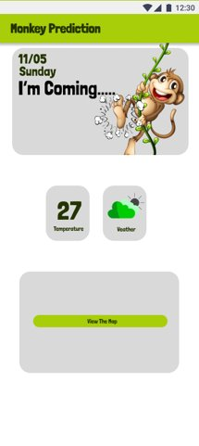
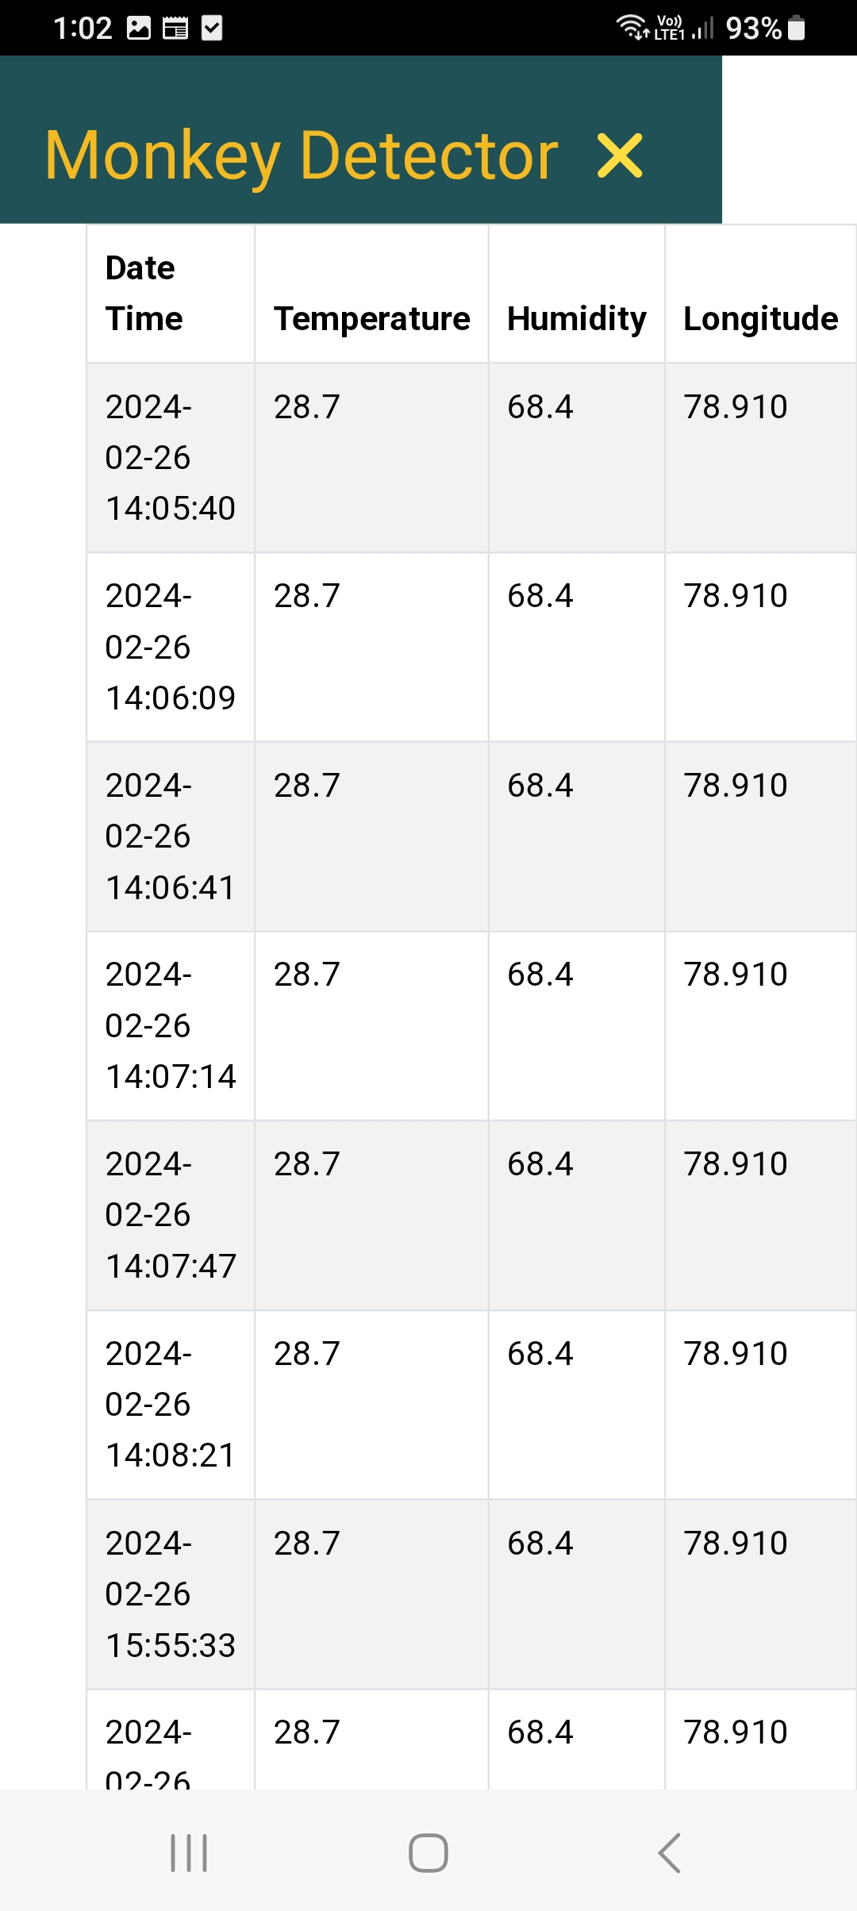
Component Methodology
Mobile Application Design

Slide 31





Tools and Technologies
Prediction Model Implementation
Supervised Machine learning Model with Multiple Linear Regression
Mobile App Development
Frond End – React Native
Back End – Python With Flask
IT20606756 | Senanayake P.M. | TMP-2023-24-074

Slide 32
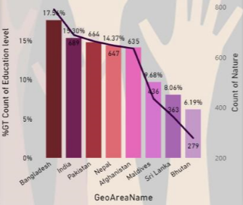
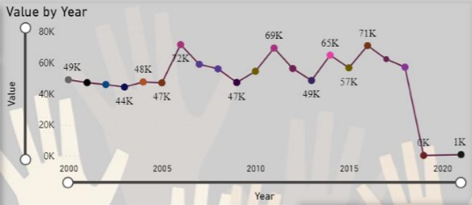
Component Methodology
Monkey's Visitation Patterns Visualization
Point out the identified mics locations.
Visualize the triggering data and summarize.

Slide 33
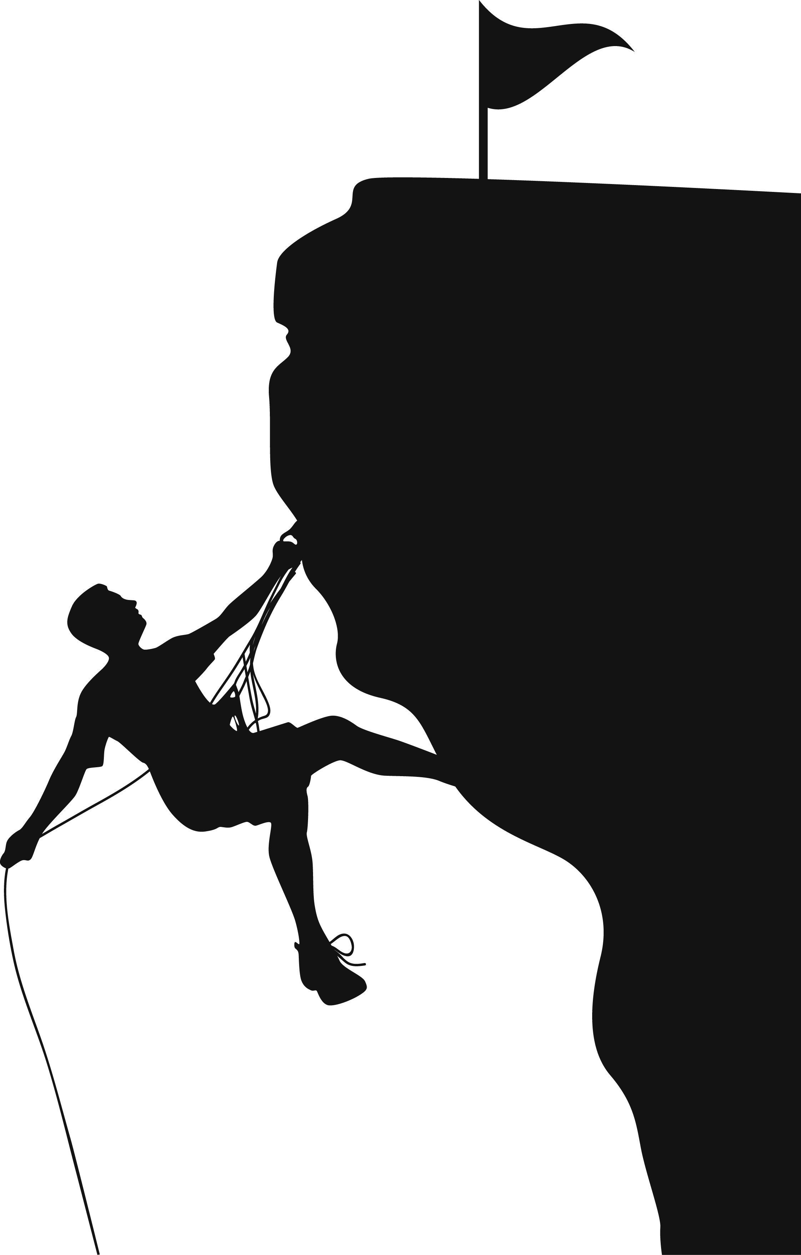
Component Methodology
Challengers Faced
Low accuracy of the model.
Not enough features of dataset to train the model.
Not fluent enough about developing mobile app.
It took so long to implement the final model.
Solutions .....
Not enough real time data.
Add the "Humidity" to dataset as a feature.
Referred many mobile app development tutorials.
Studied the model and gone through with tutorials.

Slide 34

IT20600334 | Withanage P.W.E.L.
Bachelor of Science (Hons) in Information Technology
Specializing in Data Science
Topic - Minuscule Pest Detection
IT206000334 | Withanage P.W.E.L. | TMP-2023-24-074

Slide 35
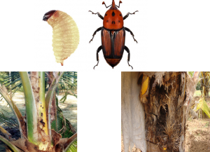


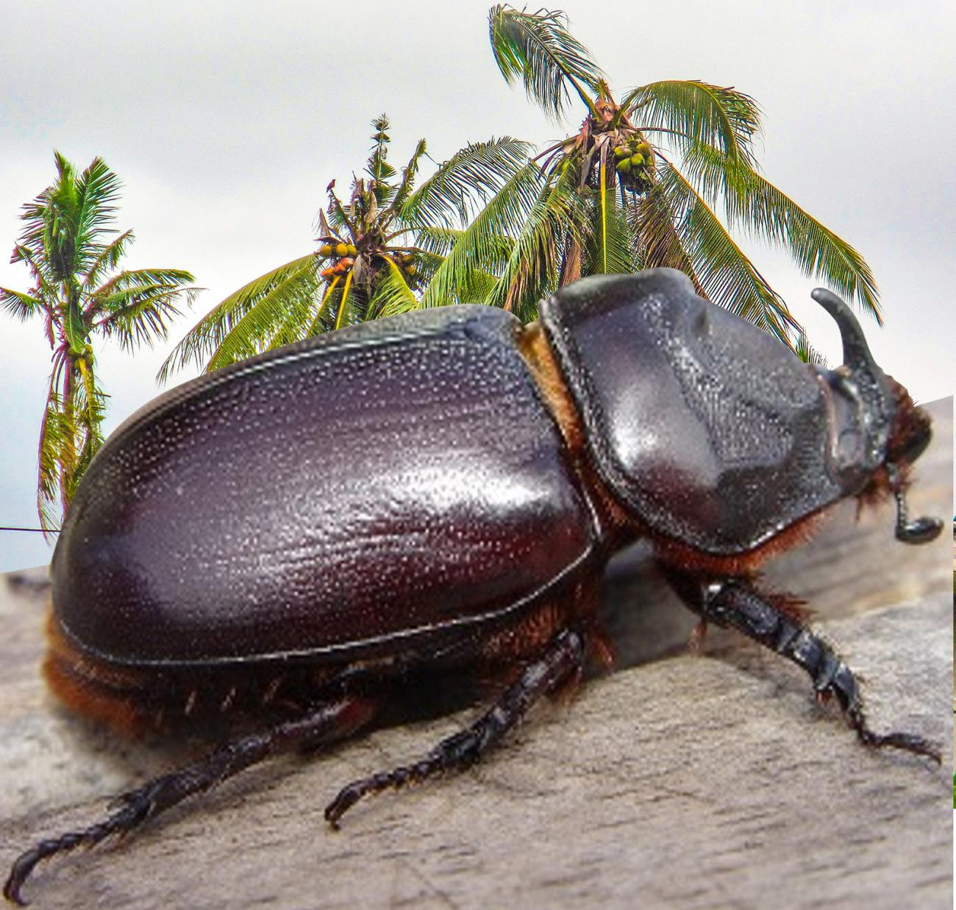
Introduction To Component
Widely Spreaded Small size coconut cultivation pests in SriLankan
Coconut Caterpillar
Whitefly
Red Weevil
Coconut Beetle
IT206000334 | Withanage P.W.E.L. | TMP-2023-24-074

Slide 36
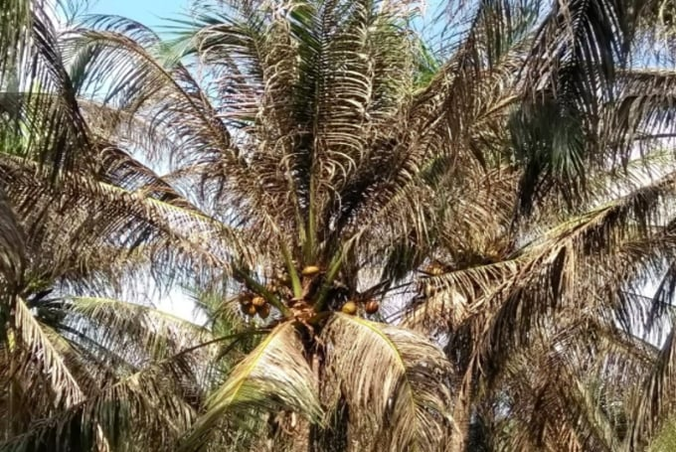
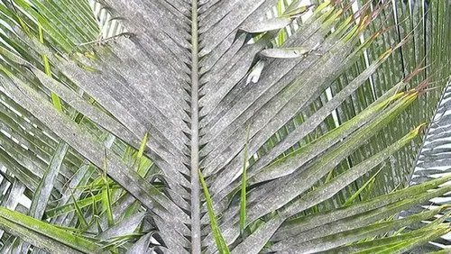
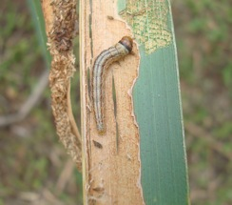
Introduction To Component
WHITE
FLY
COCONUT
CATERPILLAR
IT206000334 | Withanage P.W.E.L. | TMP-2023-24-074

Slide 37
Component Work Breakdown
Data Collection
Basic Model Implementation
Mobile Application Front End Development
Mobile Application Back End Development
CNN Pretrain Models Comparison
Research On Latest Pest Solutions
Real World Testing
IT206000334 | Withanage P.W.E.L. | TMP-2023-24-074

Slide 38
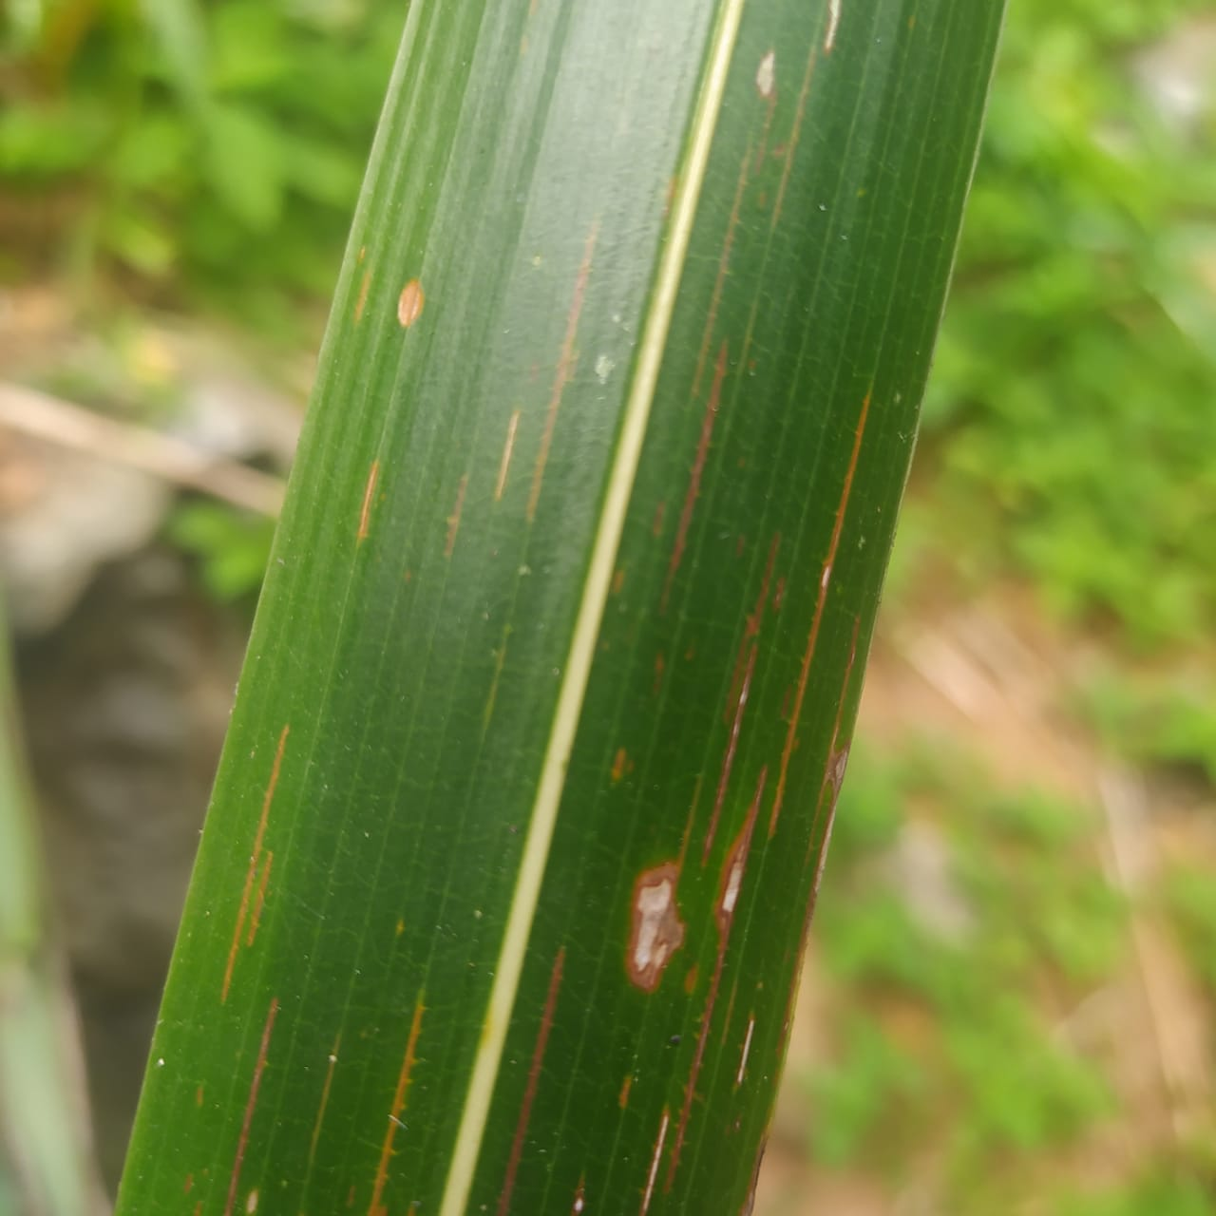
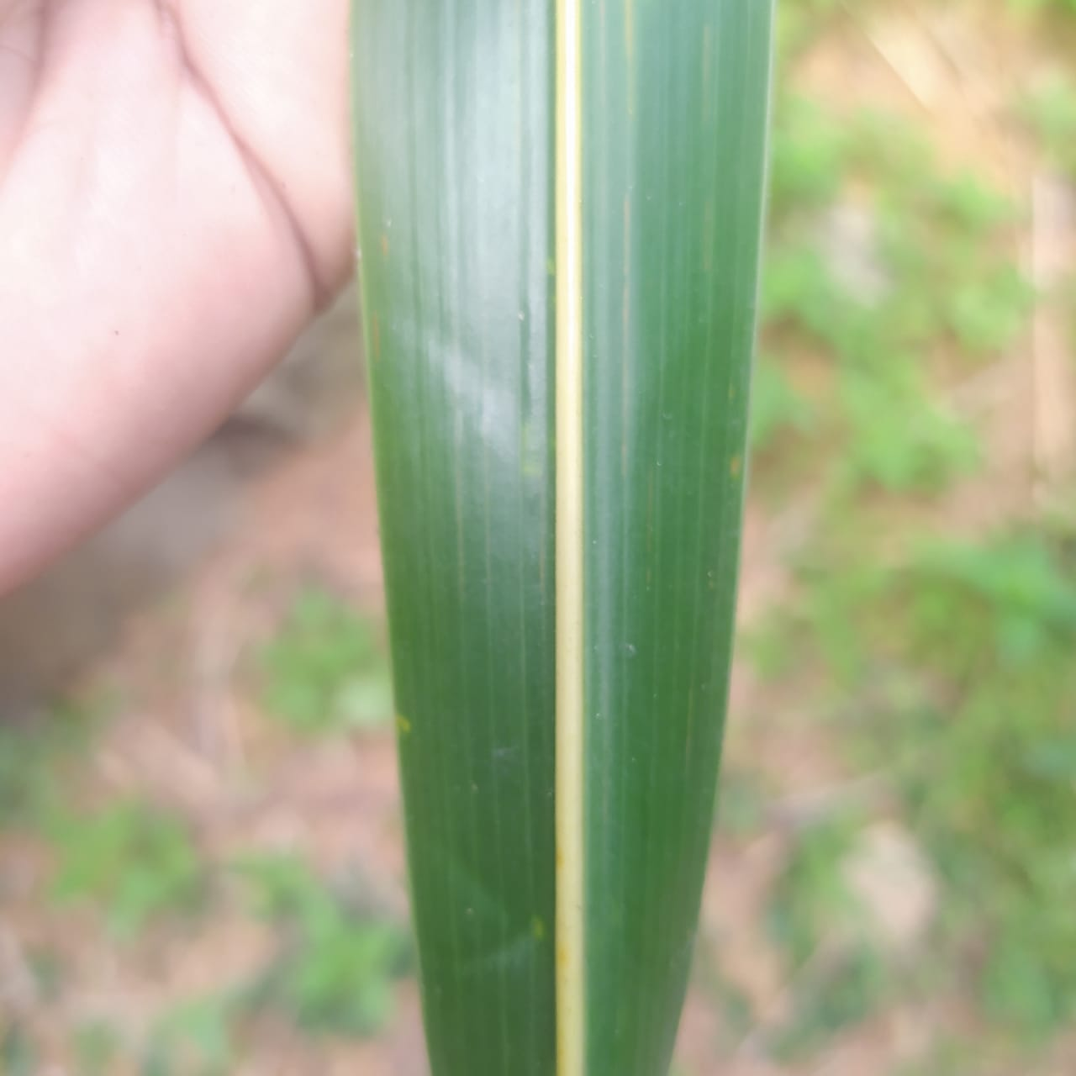
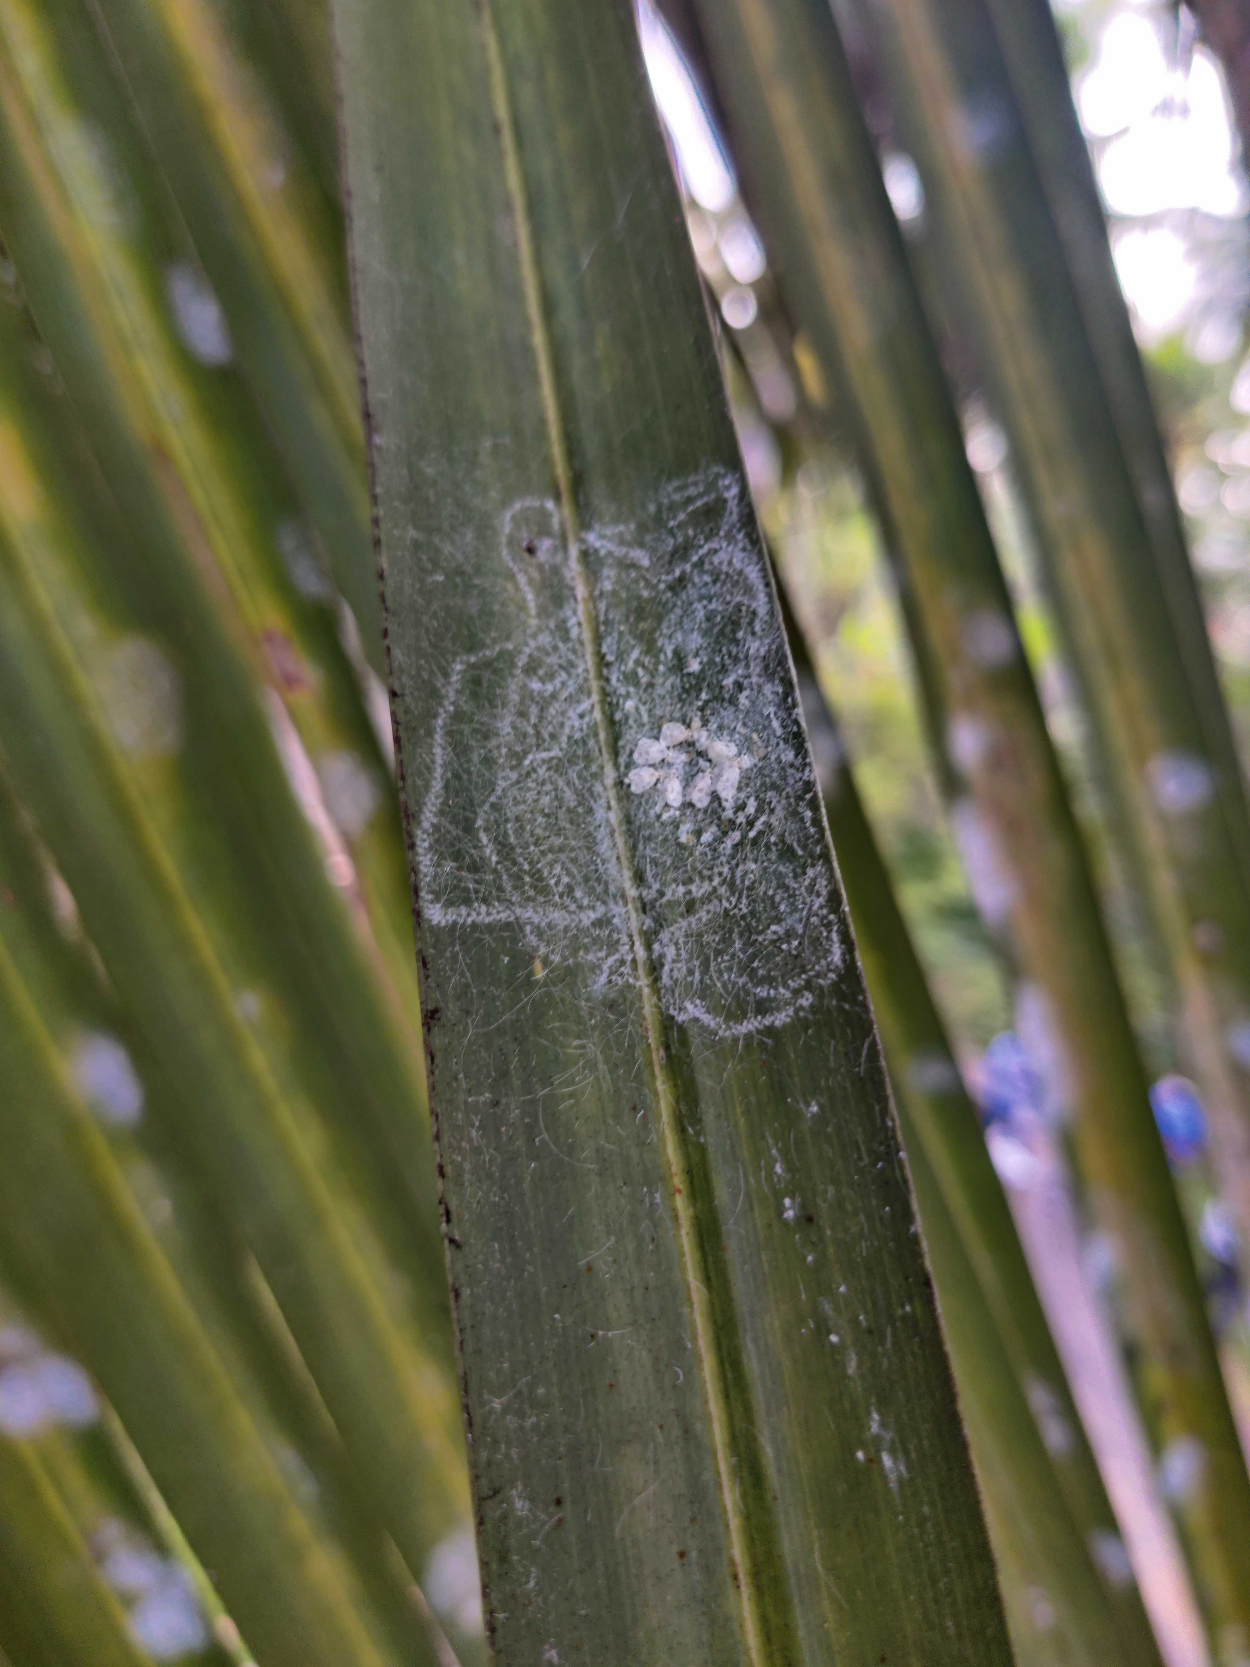
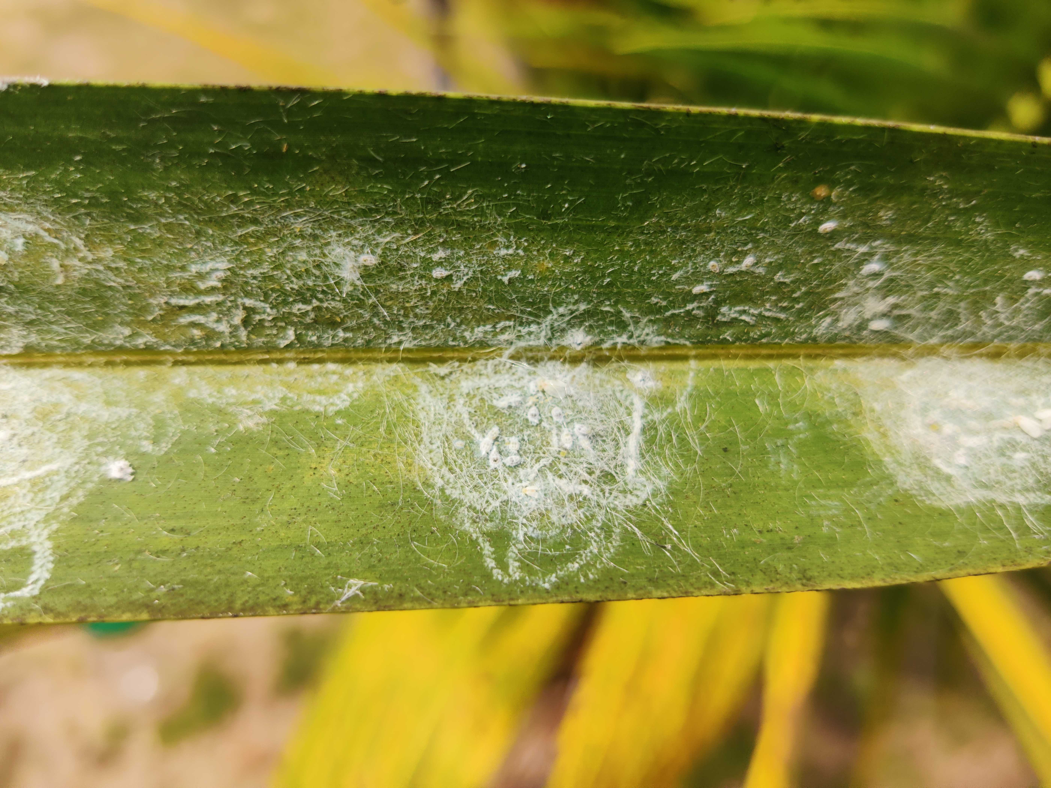
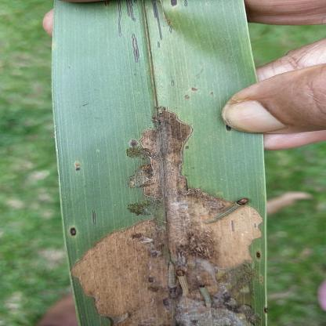
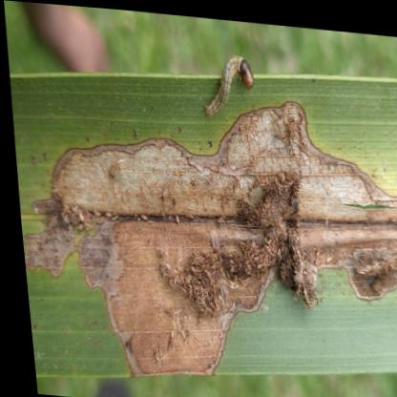

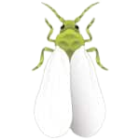
Component Methodology
Data Collection
Not Infected
Coconut Caterpillar
Whitefly
IT206000334 | Withanage P.W.E.L. | TMP-2023-24-074

Slide 39

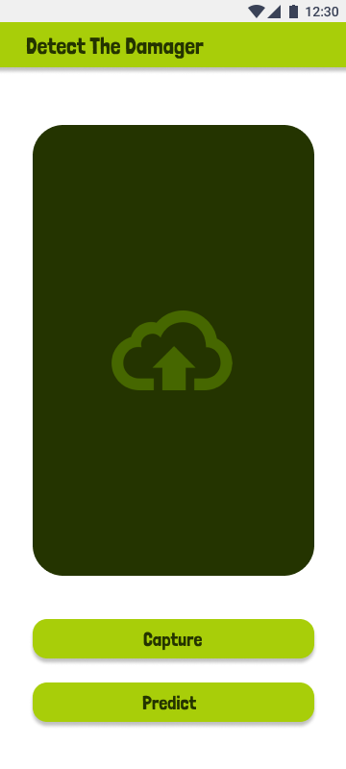
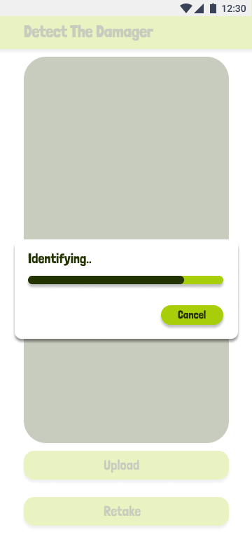
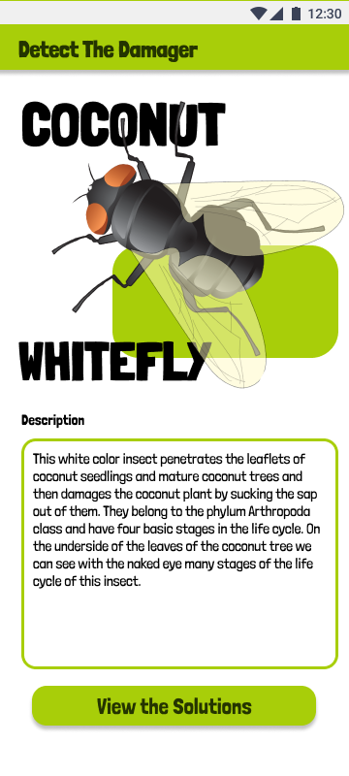
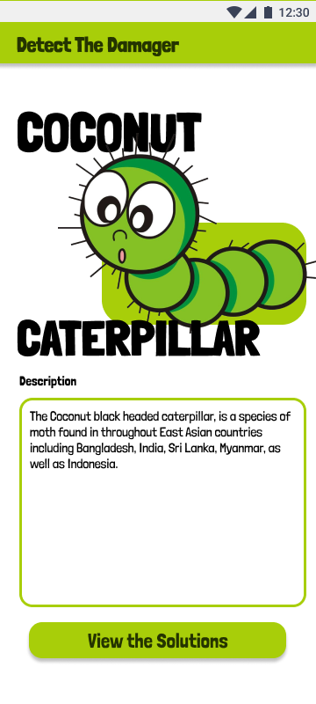
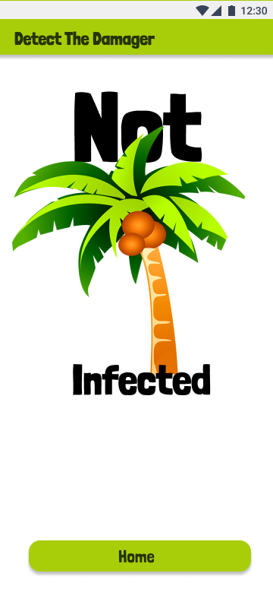
Component Methodology
Mobile Application Frontend Development
IT206000334 | Withanage P.W.E.L. | TMP-2023-24-074

Slide 40
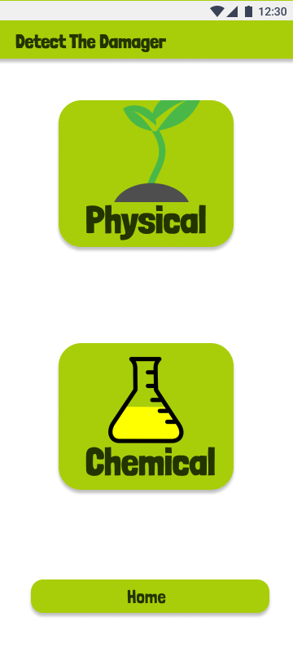
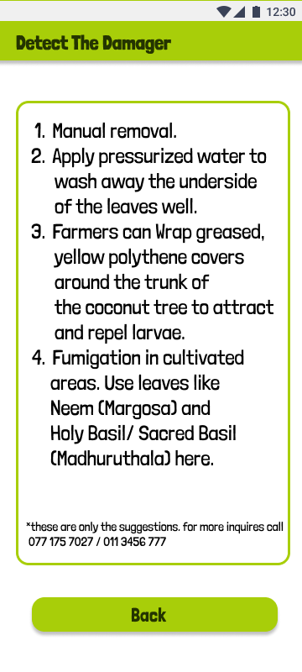
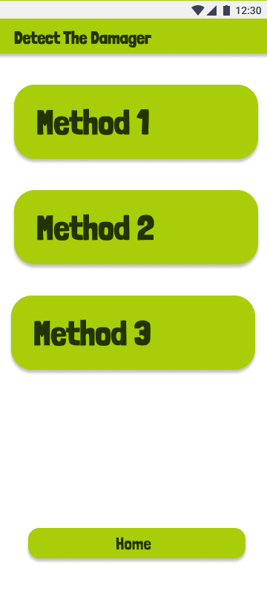
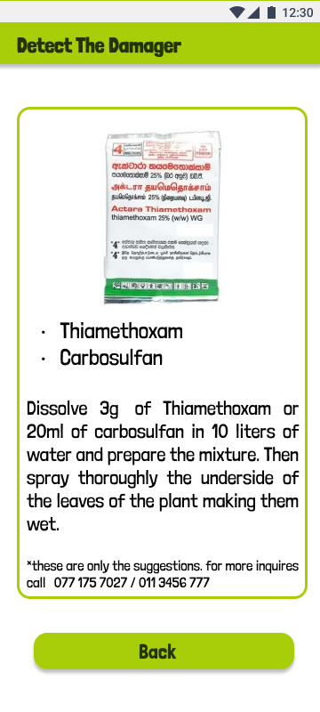
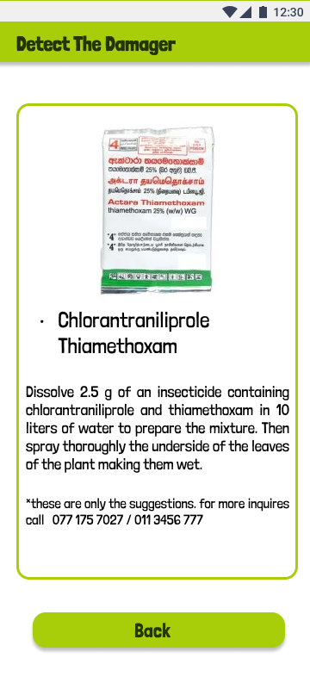
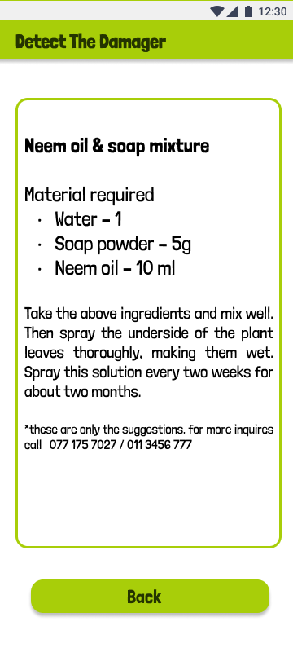
Component Methodology
Mobile Application Frontend Development
IT206000334 | Withanage P.W.E.L. | TMP-2023-24-074

Slide 41



Component Methodology
Basic Model Implementation
Binary Image Classification Model with TensorFlow Keras
Focal Loss for imbalance dataset
IT206000334 | Withanage P.W.E.L. | TMP-2023-24-074

Slide 42

Component Methodology
Pretrained Models Implementation & Comparison
Results
Pretrained Model | Accuracy | Size in MB
MobileNetV2 | 0.97 | 10.12
InceptionV3 | 0.97 | 85.17
VGG16 | 0.98 | 56.63
DenseNet121 | 0.88 | 27.85
ResNet50 | 0.62 | 91.92
MobileNetV2
IT206000334 | Withanage P.W.E.L. | TMP-2023-24-074

Slide 43
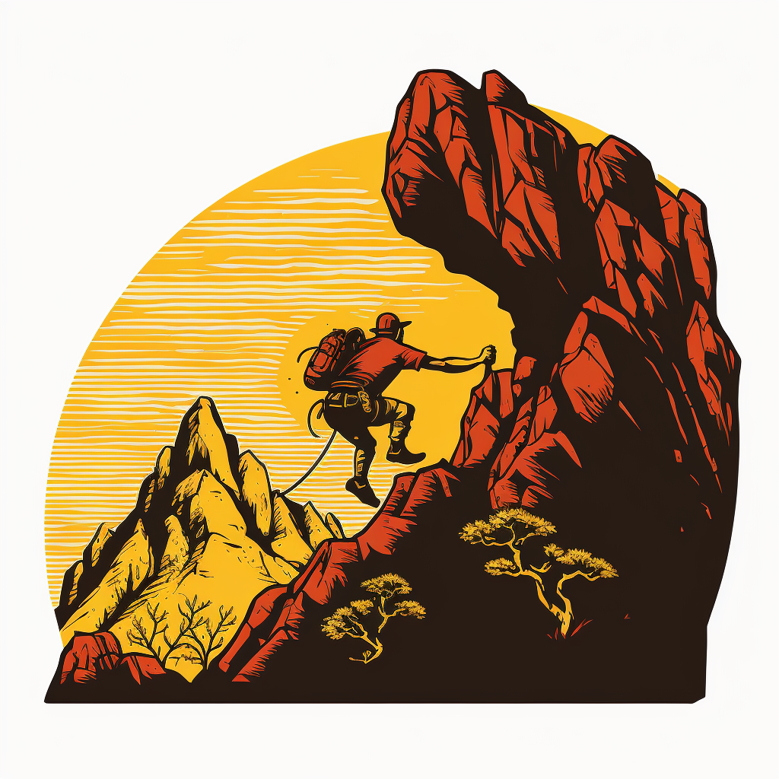
Component Methodology
Pretrained Models Implementation & Comparison
Challengers Faced
Imbalanced Dataset
Overfitting Dataset
Ways used to Solve
Balance the Dataset
Under sampling, Over sampling, SMOTE, Focal Loss
Manual Balancing
Change the Optimizer (SGD Optimizer)
IT206000334 | Withanage P.W.E.L. | TMP-2023-24-074

Slide 44

Component Methodology
Mobile Application Backend Development
Develop the Backend with python Flask framework
IT206000334 | Withanage P.W.E.L. | TMP-2023-24-074

Slide 45

Demonstration

Slide 46
Thank You!

